Slide 1
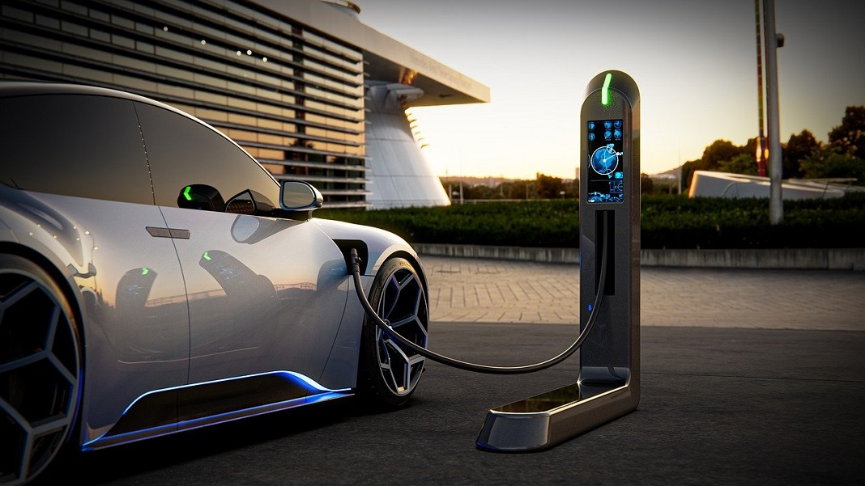
Presentation PROJECT EV
Kotomi Oda
Kaleb Cervantes
Nikhil Tarigonda

Slide 2

Introduction
Research Question:
Which characteristics of Electric Vehicles have a significant impact on
increasing their price?
Data Source:
“Cheapest Electric Cars” from Kaggle user KOUSTUBHK
(scraped data from https://ev-database.org/ in August 2021.)
Notes:
2021

Slide 3
Dimensions
c1 <- dim(full_data)
c2 <- dim(data)
data.frame(
c("Full", "Cleaned"),
c(c1[1], c2[1]),
c(c1[2], c2[2])
) %>%
kable(col.names = c("Dataset", "Rows", "Columns"))
Dataset | Rows | Columns
Full | 180 | 11
Cleaned | 124 | 11

Slide 4
Data Description
Price in UK/Germany
Acceleration
The car price in UK/Germany in pounds/euros
[£/€]
Number of Seconds taken to reach 100 km/h [seconds]
Battery Capacity
Efficiency
The amount of battery that the car can contain [kWh]
Energy Consumed for every km travelled [Wh/km]
Top Speed
Fast Charge Speed
The maximum speed that car can travel at
[km/h]
Distance covered if charged for an hour [km/h]
Number of Seats
Range
The maximum number of people the can contain
The distance car can travel when its fully charged [km]

Slide 5
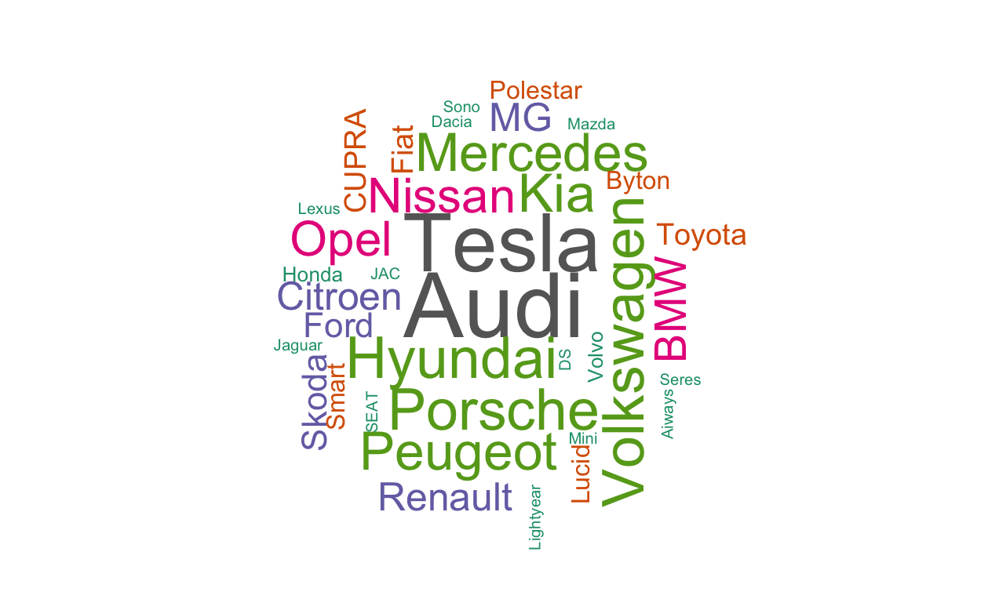
Car Manufacturers Word Cloud
Notes:
The more observations we have in our data set, the bigger the size of the manufactures name we have. We have more observations from Tesla, and Audi

Slide 6
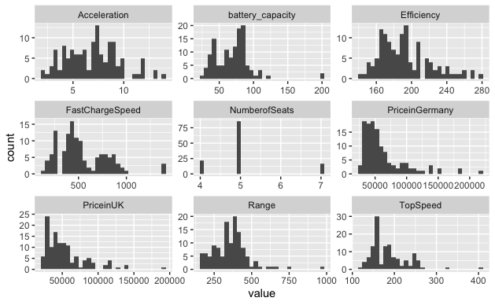
Histogram Matrix

Slide 7
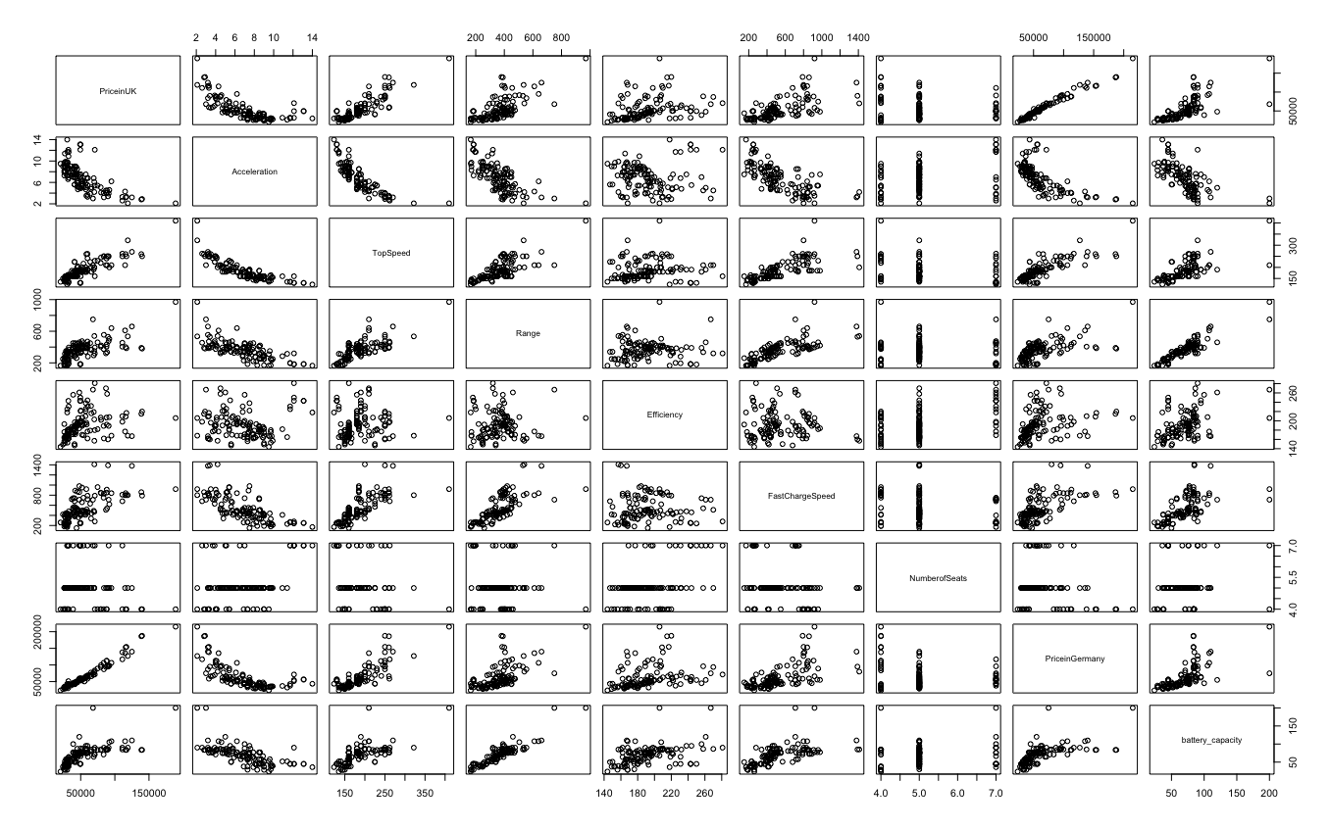
Scatterplot Matrix
Notes:
you can see some linear relationships between

Slide 8
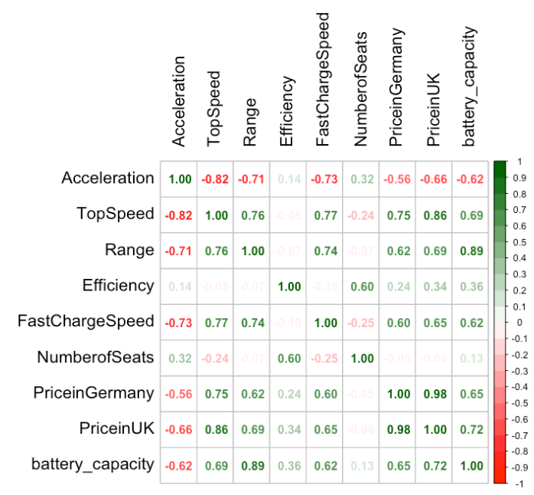
Correlation Matrix

Slide 9
Full (Untransformed) Model Diagnostics
## Shapiro-Wilk normality test ## data: . ## W = 0.9337, p-value = 1.214e-05
## studentized Breusch-Pagan test ## data: . ## BP = 23.443, df = 9, p-value = 0.005274
## Coefficients:
## Estimate Std. Error t value Pr(>|t|)
## (Intercept) -1.536e+05 2.185e+04 -7.029 1.62e-10 ***
## battery_capacity -1.061e+03 2.970e+02 -3.572 0.000520 ***
## Range 2.550e+02 6.269e+01 4.068 8.75e-05 ***
## Acceleration 6.742e+02 1.107e+03 0.609 0.543590
## TopSpeed 4.711e+02 5.054e+01 9.322 1.06e-15 ***
## Efficiency 6.790e+02 1.183e+02 5.738 8.02e-08 ***
## FastChargeSpeed 7.794e-01 7.439e+00 0.105 0.916746
## NumberofSeats -6.499e+03 1.621e+03 -4.009 0.000109 ***
## DriveFront Wheel Drive 3.247e+03 4.779e+03 0.679 0.498349
## DriveRear Wheel Drive -4.992e+03 3.922e+03 -1.273 0.205676
## Multiple R-squared: 0.8504, Adjusted R-squared: 0.8386

Slide 10
Reduced multicollinearity Model Diagnostics
## Shapiro-Wilk normality test ## data: . ## W = 0.9419, p-value = 4.334e-05
## studentized Breusch-Pagan test ## data: . ## BP = 20.588, df = 7, p-value = 0.004431
## Coefficients:
## Estimate Std. Error t value Pr(>|t|)
## (Intercept) -83996.399 13710.258 -6.127 1.27e-08 ***
## Range 31.868 15.469 2.060 0.04162 *
## TopSpeed 466.125 49.156 9.483 3.88e-16 ***
## Efficiency 304.015 47.878 6.350 4.35e-09 ***
## FastChargeSpeed 8.653 7.209 1.200 0.23249
## NumberofSeats -4657.992 1610.002 -2.893 0.00456 **
## DriveFront Wheel Drive 5725.559 3976.629 1.440 0.15262
## DriveRear Wheel Drive -3077.002 3348.928 -0.919 0.36011
## Multiple R-squared: 0.8298, Adjusted R-squared: 0.8196

Slide 11
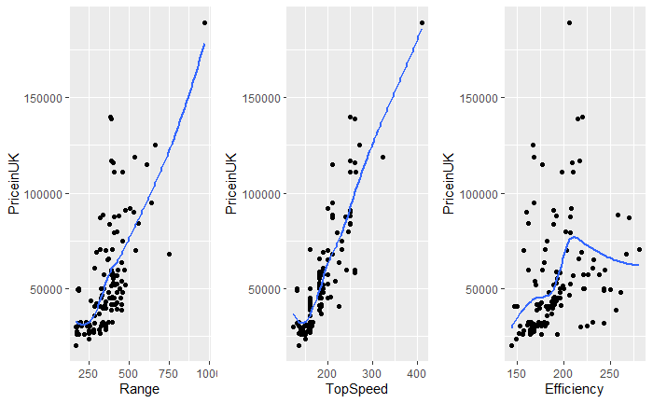
Significant Predictor Plots

Slide 12
Predictors Transformed Model Diagnostics
## Shapiro-Wilk normality test ## data: . ## W = 0.92452, p-value = 3.205e-06
## studentized Breusch-Pagan test ## data: . ## BP = 20.903, df = 9, p-value = 0.01309
## bcPower Transformation to Normality
## Est Power Rounded Pwr Wald Lwr Bnd Wald Upr Bnd
## Y1 -0.6046 -0.5 -0.9076 -0.3016
## Coefficients:
## Estimate Std. Error t value Pr(>|t|)
## (Intercept) -1.096e+05 6.396e+04 -1.713 0.0894 .
## log(Range) 5.197e+03 5.766e+03 0.901 0.3693
## poly(TopSpeed, 2, raw = T)1 1.294e+02 2.005e+02 0.645 0.5201
## poly(TopSpeed, 2, raw = T)2 7.206e-01 3.776e-01 1.908 0.0589 .
## poly(Efficiency, 2, raw = T)1 6.868e+02 4.739e+02 1.449 0.1500
## poly(Efficiency, 2, raw = T)2 -9.405e-01 1.147e+00 -0.820 0.4140
## FastChargeSpeed 1.653e+01 7.877e+00 2.099 0.0380 *
## NumberofSeats -4.253e+03 1.627e+03 -2.615 0.0101 *
## DriveFront Wheel Drive 2.675e+03 4.806e+03 0.557 0.5790
## DriveRear Wheel Drive -4.159e+03 3.638e+03 -1.143 0.2553
## Multiple R-squared: 0.8318, Adjusted R-squared: 0.8186
Notes:
tomorrow let’s do a mock presentation

Slide 13
Full (Transformed) Model Diagnostics
## Shapiro-Wilk normality test ## data: . ## W = 0.97816, p-value = 0.04186
## studentized Breusch-Pagan test ## data: . ## BP = 38.6, df = 9, p-value = 1.36e-05
## Coefficients:
## Estimate Std. Error t value Pr(>|t|)
## (Intercept) 1.802e-02 1.993e-03 9.046 4.61e-15 ***
## log(Range) -4.688e-04 1.796e-04 -2.610 0.010271 *
## poly(TopSpeed, 2, raw = T)1 -2.935e-05 6.246e-06 -4.699 7.35e-06 ***
## poly(TopSpeed, 2, raw = T)2 3.747e-08 1.176e-08 3.185 0.001868 **
## poly(Efficiency, 2, raw = T)1 -5.225e-05 1.476e-05 -3.539 0.000582 ***
## poly(Efficiency, 2, raw = T)2 9.557e-08 3.573e-08 2.675 0.008582 **
## FastChargeSpeed -5.021e-07 2.454e-07 -2.046 0.043037 *
## NumberofSeats 2.721e-05 5.067e-05 0.537 0.592253
##DriveFront Wheel Drive -7.778e-06 1.497e-04 -0.052 0.958662
##DriveRear Wheel Drive 9.140e-05 1.133e-04 0.807 0.421625
## Multiple R-squared: 0.8649, Adjusted R-squared: 0.8542

Slide 14
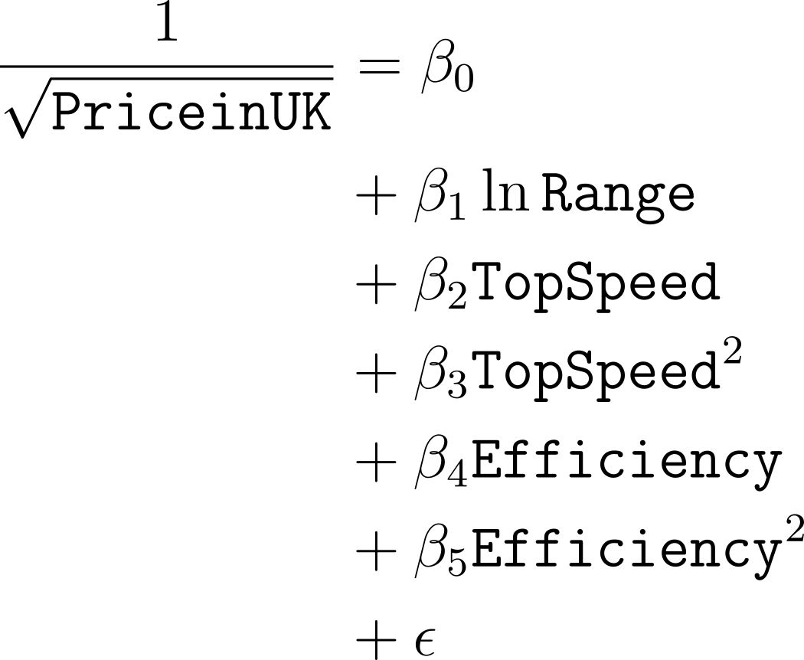
Final Model

Slide 15
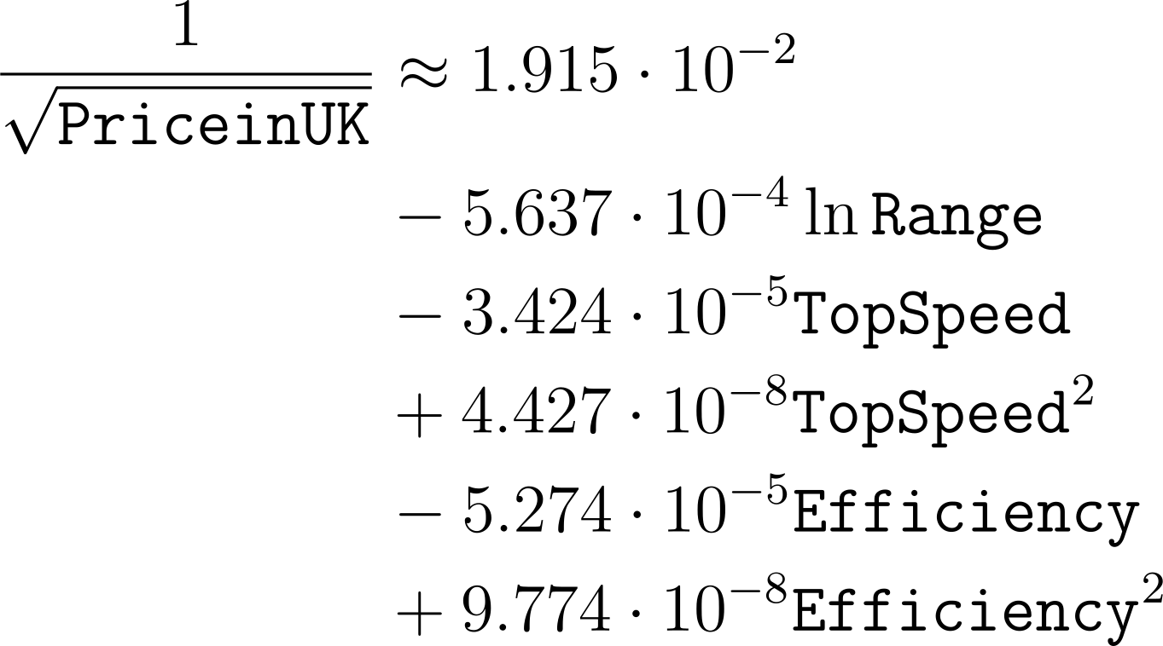
Final Model
Notes:
I [Kaleb] need to speak about some interpretation while on this slide

Slide 16
Final Model Coefficients
 | Estimate | Std. Error | t value | Pr(>|t|)
(Intercept) | 0.0191479 | 0.0015399 | 12.434199 | 0.0000000
log(Range) | -0.0005637 | 0.0001617 | -3.487202 | 0.0006865
poly(TopSpeed, 2, raw = T)1 | -0.0000342 | 0.0000047 | -7.333547 | 0.0000000
poly(TopSpeed, 2, raw = T)2 | 0.0000000 | 0.0000000 | 4.588899 | 0.0000112
poly(Efficiency, 2, raw = T)1 | -0.0000527 | 0.0000139 | -3.789260 | 0.0002394
poly(Efficiency, 2, raw = T)2 | 0.0000001 | 0.0000000 | 2.889679 | 0.0045905
Multiple R-squared: 0.8588
Adjusted R-squared: 0.8528

Slide 17
Outliers
Outliers were defined as points that had both:
Absolute Standardized residuals larger than 2 (i.e. high residual).
Absolute hatvalue higher than 2 times the mean (i.e. high leverage).
 | Name | PriceinUK
14 | Tesla Roadster | 189000
35 | Mercedes EQV 300 Long | 70665
43 | Tesla Cybertruck Dual Motor | 48000
44 | Tesla Cybertruck Tri Motor | 68000

Slide 18
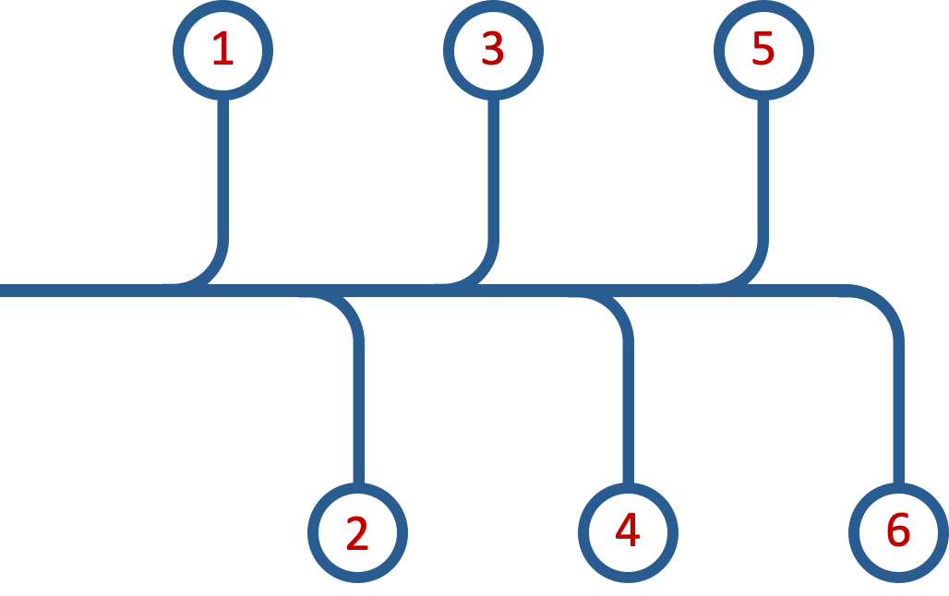
Clean Data
Reduce Multicollinearity
Transform Response
Process
Make Full Model
Transform Predictors
Stepwise-selection

Slide 19
Significant Predictors
Range
Efficiency
Log Transformation
Polynomial Transformation
Top Speed
Polynomial Transformation

Slide 20
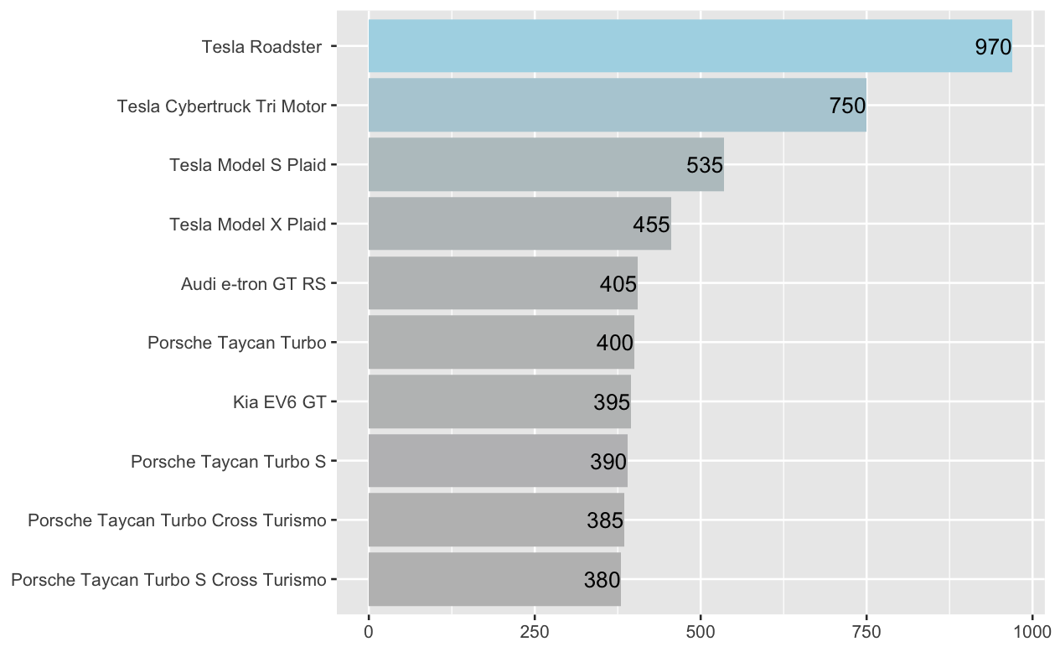
Interpreting Range
with all other predictors in the model held fixed, the interpretation of the estimated Range is that a unit increase in log(Range) is associated with an decrease in 1/sqrt(PriceinUK) by 0.0005637.
The car with highest travel Range is Tesla Roadster with about 970 km on a full charge.

Slide 21
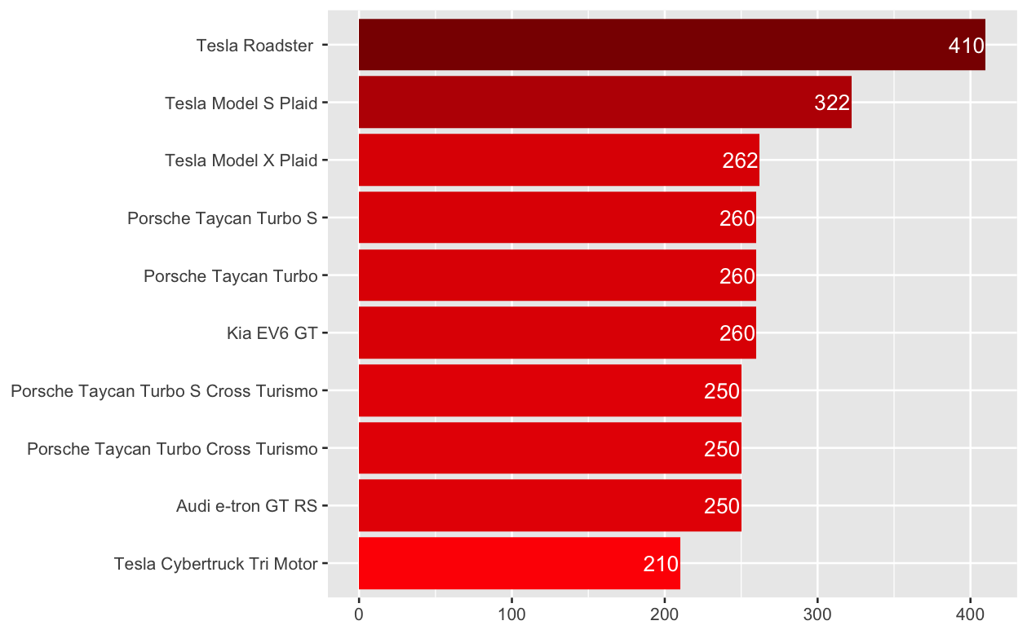
Interpreting Top Speed
With Range and Efficiency fixed, an increase in TopSpeed is associated with quadratic growth in 1 / sqrt(PriceinUK).
The car that can travel with maximum Speed is Tesla Roadster with about 410 km/h.

Slide 22
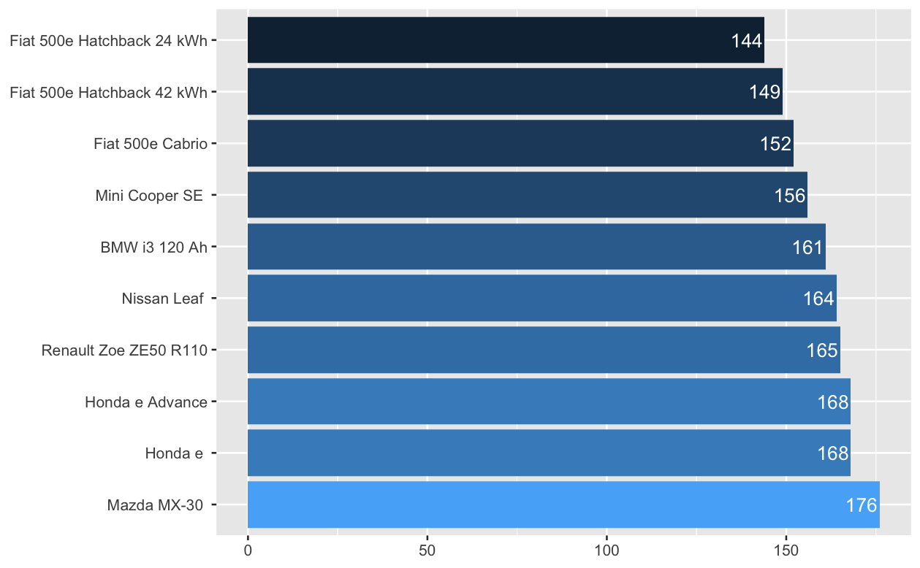
Interpreting Efficiency
With Range and TopSpeed fixed, an increase in Efficiency is associated with quadratic growth in 1 / sqrt(PriceinUK).
The most Efficient car is Fiat 500e with an efficiency of about 144 Wh for every km.

Slide 23
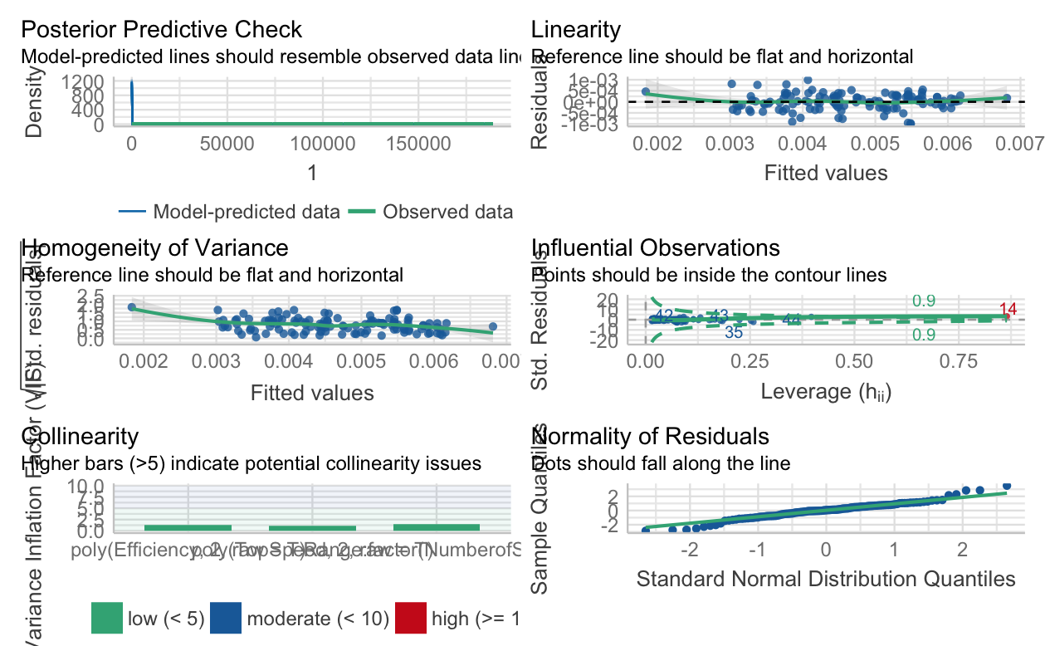

Slide 24
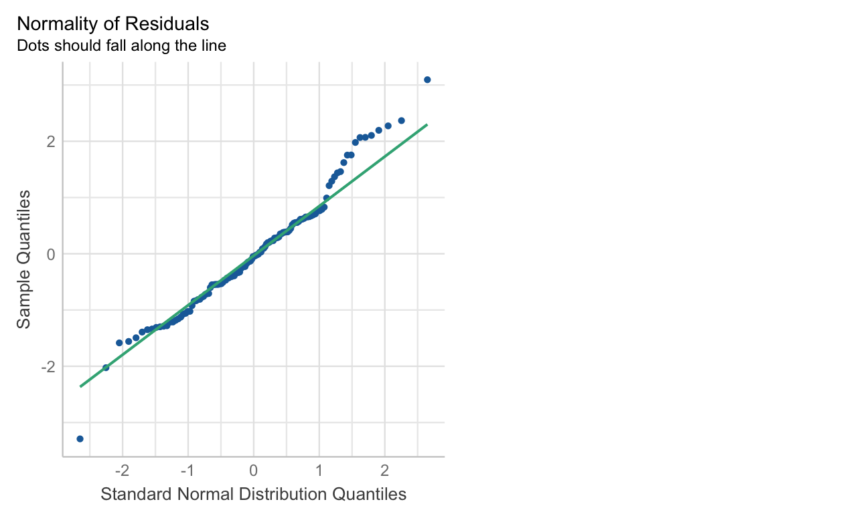
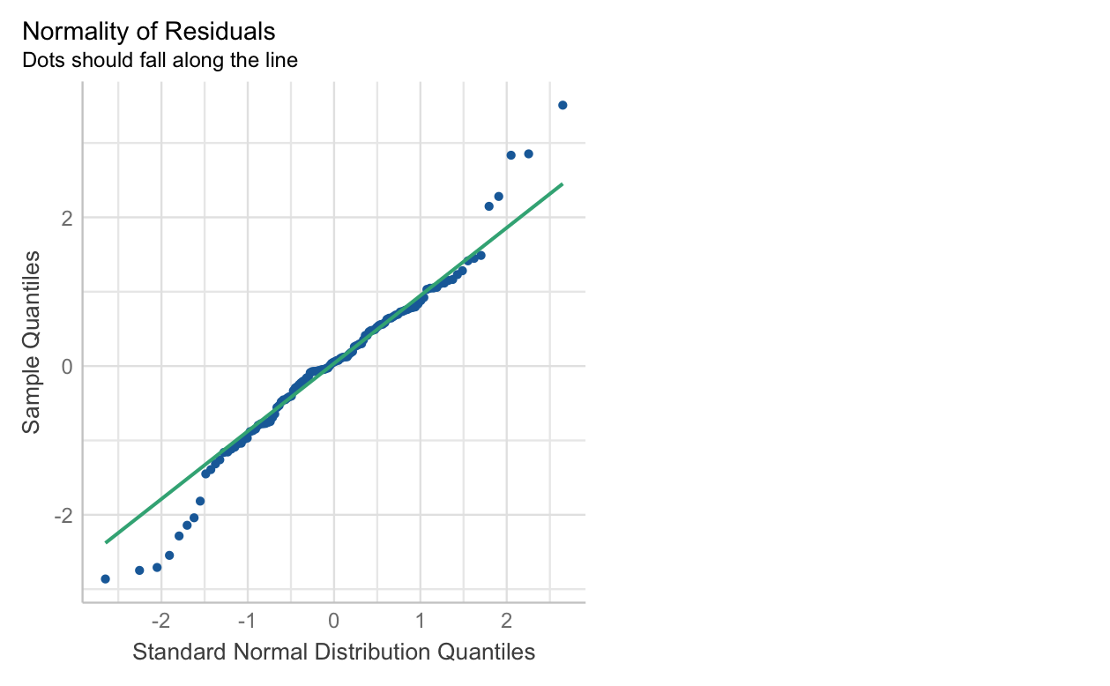
Normality - Reduced vs Final (qq plot)

Slide 25
Normality - Reduced vs Final (qq plot)
## W = 0.97628, p-value = 0.02778
## W = 0.94148,
p-value =4.056e-05

Slide 26
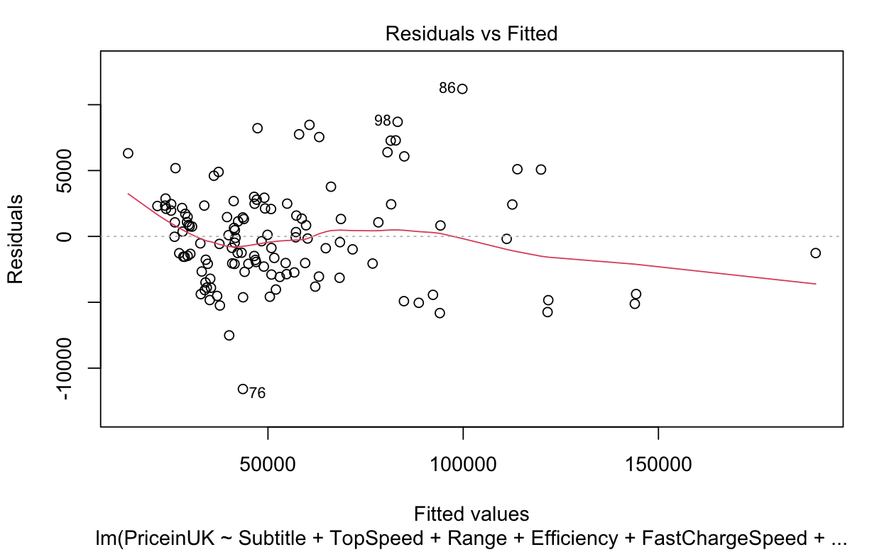
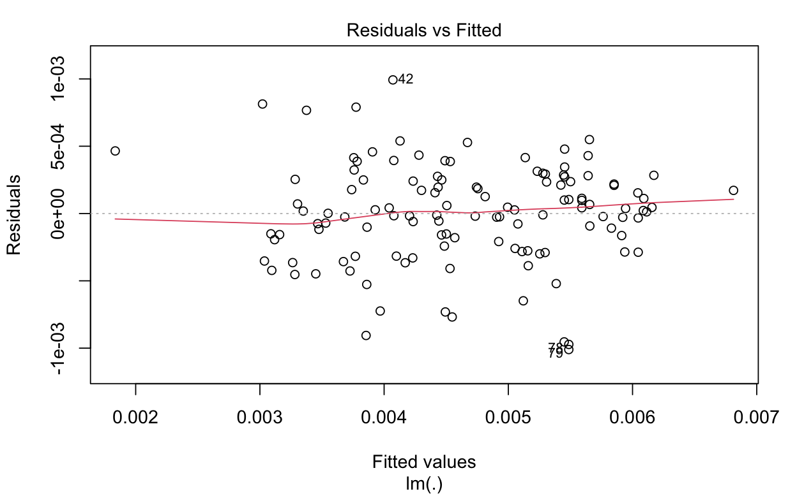
Variance - Reduced vs Final

Slide 27
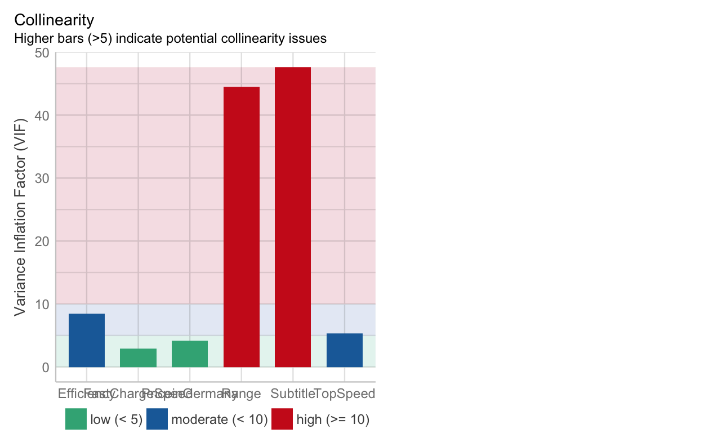
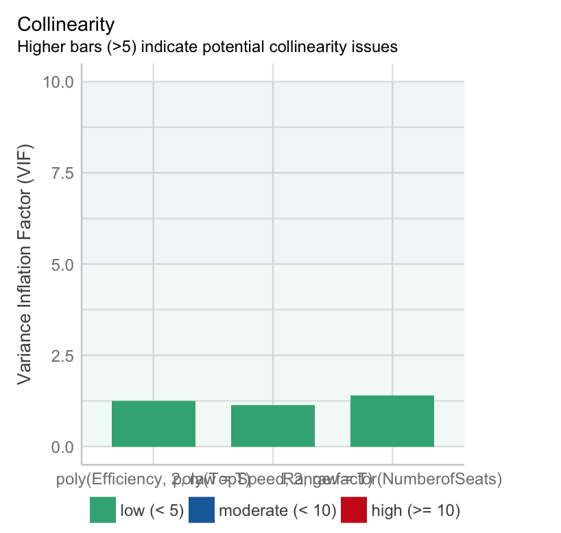
Collinearity - Reduced vs Final

Slide 28


Prediction
Name | Manufacturer | TopSpeed | Range | Efficiency | Price in UK | Predictions | Difference | Percentage
Nissan Leaf | Nissan | 144 | 220 | 164 | 25995 | 27111.53 | 1116.53 | 4.12
Renault Zoe ZE50 R110 | Renault | 135 | 315 | 165 | 26795 | 27344.29 | 549.29 | 2.01
Nissan e-NV200 Evalia | Nissan | 123 | 165 | 218 | 30255 | 28978.48 | -1276.52 | -4.41
Volkswagen ID.3 Pure | Volkswagen | 160 | 275 | 164 | 27120 | 31718.42 | 4598.42 | 14.5
Nissan Leaf e+ | Nissan | 157 | 325 | 172 | 30445 | 34013.73 | 3568.73 | 10.49
BMW i3 120 Ah | BMW | 150 | 235 | 161 | 31305 | 28042.04 | -3262.96 | -11.64
Mercedes EQA 250 | Mercedes | 160 | 355 | 187 | 43495 | 39259.23 | -4235.77 | -10.79
DS3 Crossback E-Tense | DS | 150 | 250 | 180 | 31500 | 32256.26 | 756.26 | 2.34
BMW i3s 120 Ah | BMW | 160 | 230 | 165 | 32305 | 30831.99 | -1473.01 | -4.78

Slide 29
Challenges
Data Preprocessing and Data Cleaning was a challenge as the dataset had NA’s.
Dropping a predictor due to collinearity alone was not enough.
Model had to be reduced and transformed multiple times until we found one which was a good fit.

Slide 30
Conclusion
We were able to fit a model which predicts the prices of electric vehicles with slight margin of errors.
Since the model doesn’t account for only high priced cars, it may not be a good fit for cars which are high in price.
The margin of error increases with increase in price of the car as there will be other multiple factors.
For future study: an increase in number of observations and predictors may lead us to achieve better models for prediction.

Slide 31


